Slide 1
Top 10 Issues in Agricultural Leases for Landlords and Tenants
Daniel J. Drazan and J. David Zehntbauer
Moderated by Stephanie Bradley Fryer

Slide 2
1. Due Diligence
Economic Issues

Slide 3
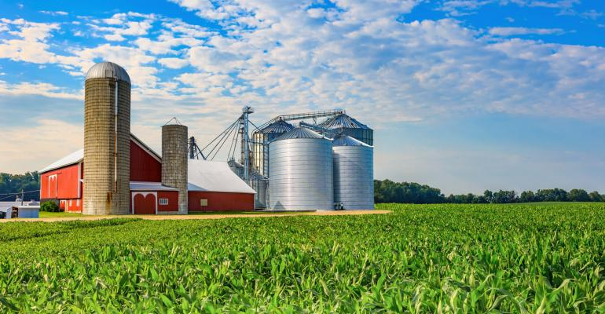
Condition of Land, Buildings and Equipment
Tenant: Perform inspections.
ii. Landlord: Disclose known material defects.

Slide 4
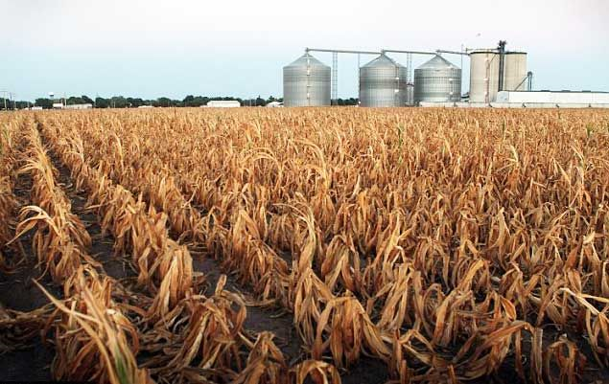
Environmental
i. Background: Both “owners” and “operators” are jointly and severally liable.
ii. Phase I environmental site assessment or ESA: Study of public records and background information concerning the use of the property and the adjacent properties. Does not include testing of soil, water or air samples.

Slide 5
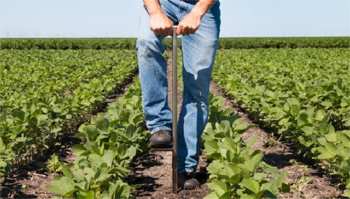
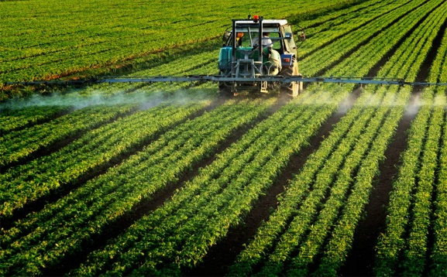
Environmental
ESA Phase II: Study that includes soil, ground water, and/or air samples. If contamination is found, a report on a Phase II ESA will typically provide recommendations for remediation.
Tenant: Environmental investigation before leasing the property.
ii. Landlord: Tenant to provide a copy of any Phase I ESA report. Control over the performance of any Phase II testing.

Slide 6
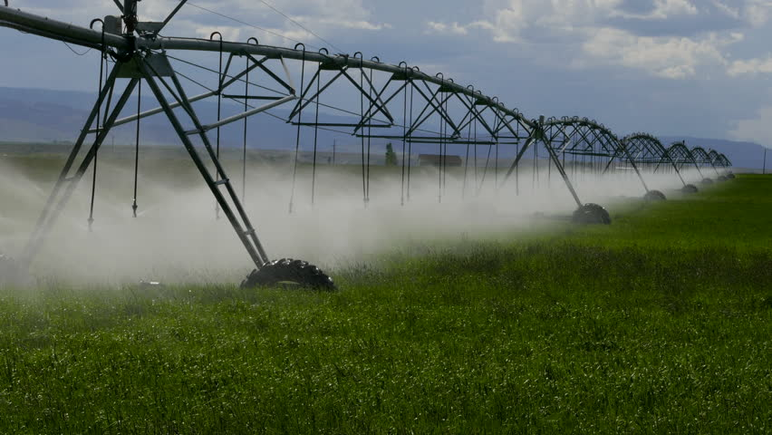
Water Rights
Tenant: Availability of water and right to such water should be verified.
ii. Landlord: Landlord should be prepared to provide documentation of its water rights.
iii. Water Rights Red Flags:
Is your prospective landlord using water without a water right or inconsistent with a water right?
Is there a water right owned by your prospective landlord without water actually being used?

Slide 7
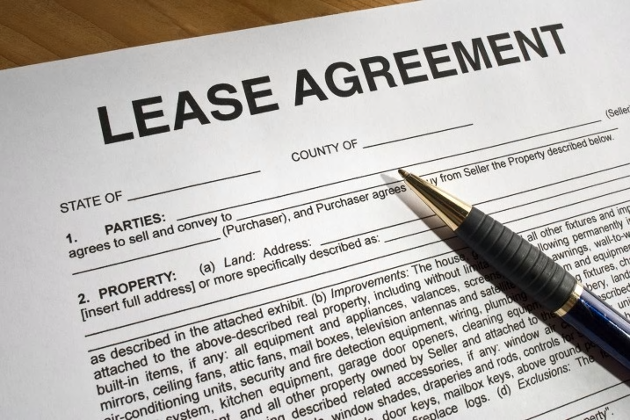
2. The Lease Agreement
“Standard” forms for agricultural leases not generally available. Often primarily commercial in nature, but may contain residential elements if a dwelling is included.

Slide 8
3. Rent
i. Base Rent.
ii. Adjustments to Base Rent.
iii. Expenses: Taxes, Insurance and Utilities.
iv. Self-Help offset or deduction.

Slide 9
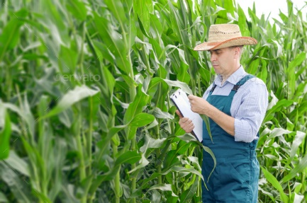
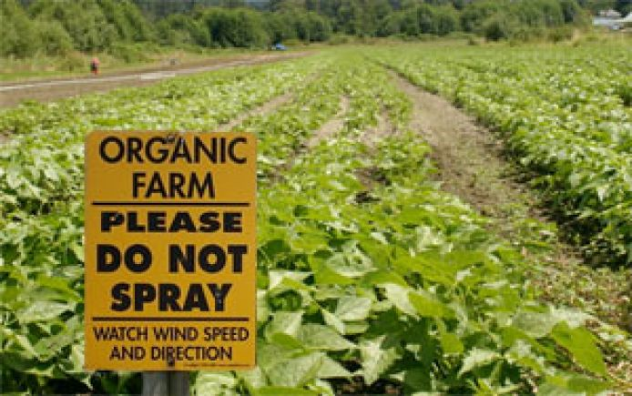
4. Use of the Premises
i. Landlord: Confirm any specific conditions to use.
ii. Tenant: Seek flexibility in permitted use.

Slide 10
5. Condition of the Premises; Maintenance and Repair
i. Landlord: Typically AS IS. Obligations typically include structure, foundation and roof.
ii. Tenant: Any improvements or repairs promised by landlord should be specified in the lease. Amortize cost of repairs of a capital nature.

Slide 11
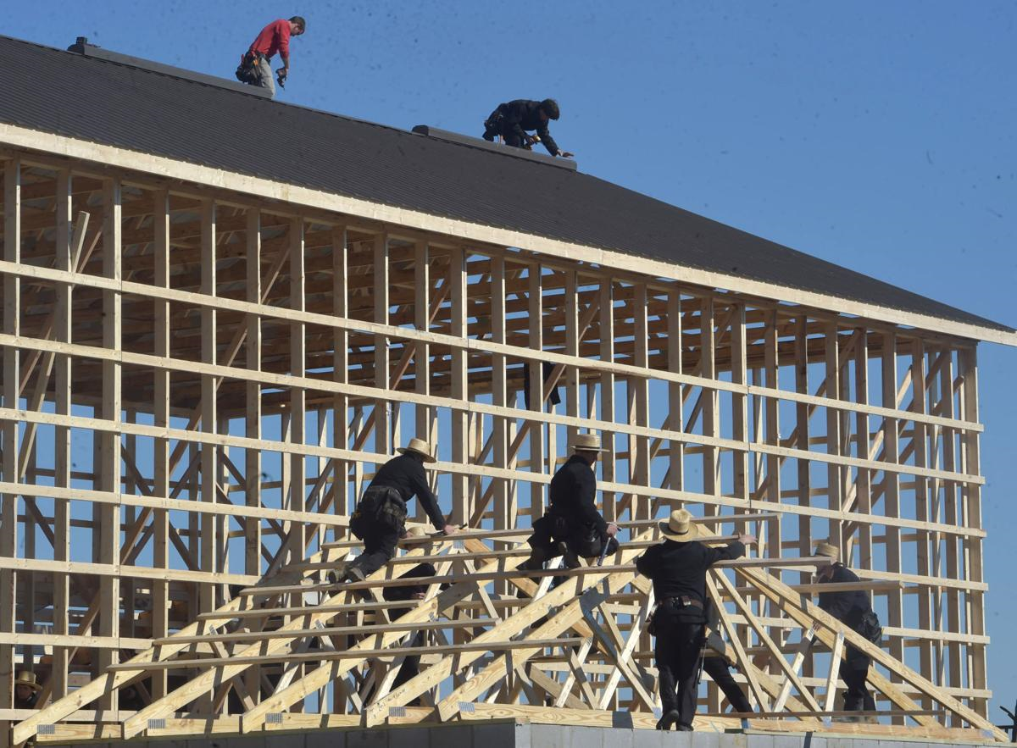
6. Alterations During the Term
i. Landlord consent required?
ii. Ownership of alterations?

Slide 12
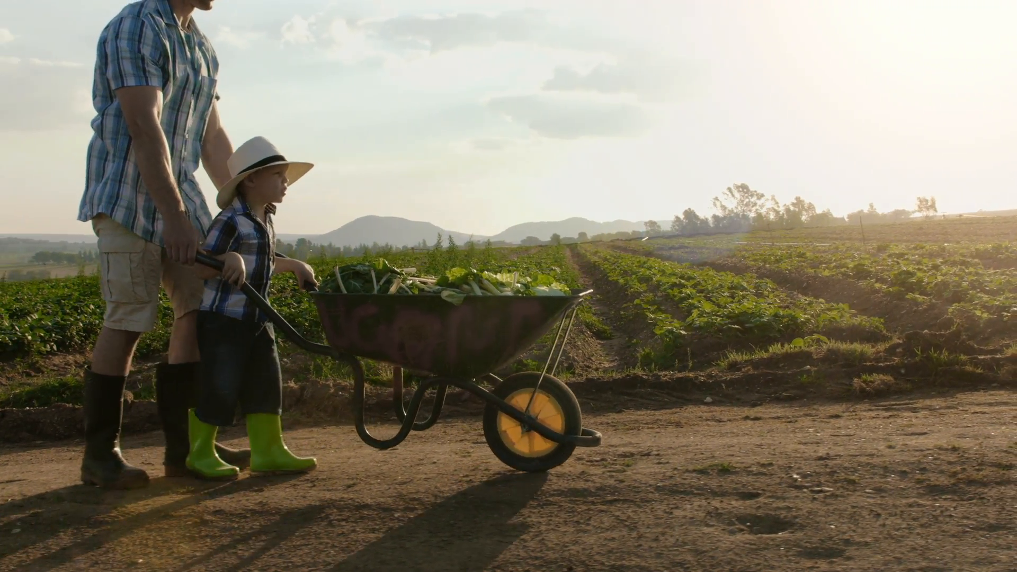
7. Assignment and Subleasing
i. Landlord consent required?
ii. What process and documentation are involved?

Slide 13
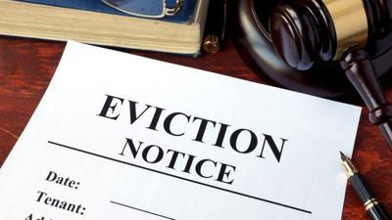
8. Default and Remedies
i. What constitutes a “Default”?
ii. Notice and opportunity to cure.
iii. Landlord right to evict.
iv. Tenant’s personal property, equipment and crops.

Slide 14
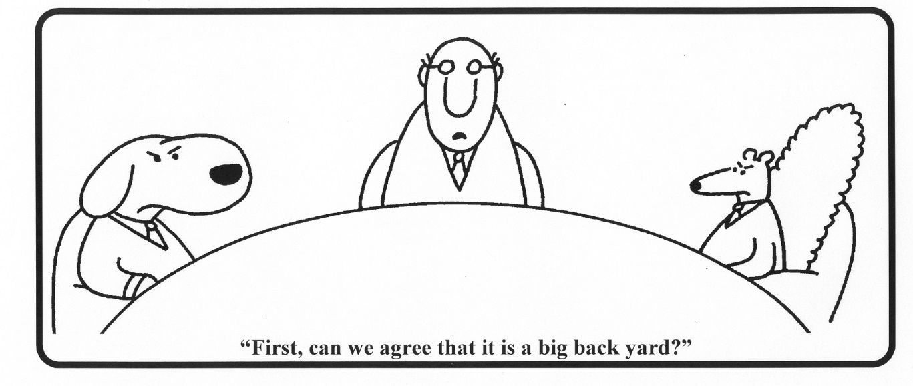
9. Alternative Dispute Resolution
i. Mediation.
ii. Arbitration.

Slide 15
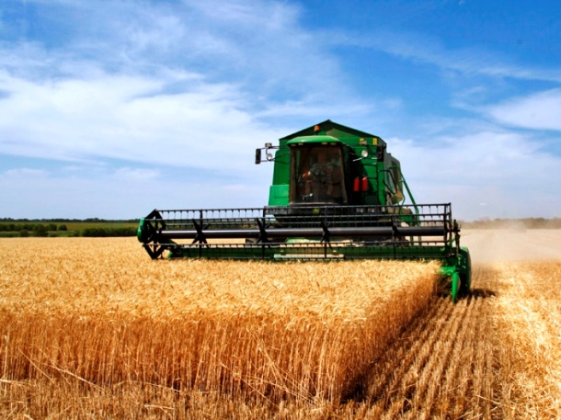
10. Special Agriculture Considerations
i. Right to Harvest: ORS 91.230
ii. Hemp and Marijuana

Slide 16
Questions?
Dan Drazan
ddrazan@dunncarney.com
503.306.5347
J. David Zehntbauer
dzehntbauer@dunncarney.com
503.306.5320
Stephanie Bradley Fryer
Stephanie@bradleyfryercounsel.com
325-307-8660

