Slide 1
All About NASS and You!
Providing useful agricultural data to help data users work smarter. . .

Slide 2
Who is NASS?
As the official statistical agency of the USDA, the National Agricultural Statistics Service provides timely, accurate, and useful statistics in service to U.S. agriculture.
Notes:
TALKING POINTS:
NASS Mission
Our goals today are to:
Provide a short introduction to NASS, starting with a little history.
Show you how we collect our data with the help of our in-house public affairs team and highlight some of our current and upcoming surveys and censuses
And share with you just how important the data we produce are/how they directly benefit our farmers, ranchers, local and national governments, trade associations, agribusinesses, universities, and many others.

Slide 3
Our History
First Agricultural Statistician
The Birth of USDA
George Washington (August 1791)
8 survey questions to 5 states
Focused on land values, prices, yields
Established by Lincoln (1862)
Intended for information gathering
First crop report: July 1863
Notes:
TALKING POINTS:
Some history on NASS:
In August, 1791, George Washington was our first agricultural statistician.
He distributed 8 survey questions to 5 states, focusing on land values, prices, and yields.
Abe Lincoln, in 1862, established the U.S. Department of Agriculture.
USDA was to gather information on U.S. agriculture, and the first crop report occurred in July of 1863.

Slide 4
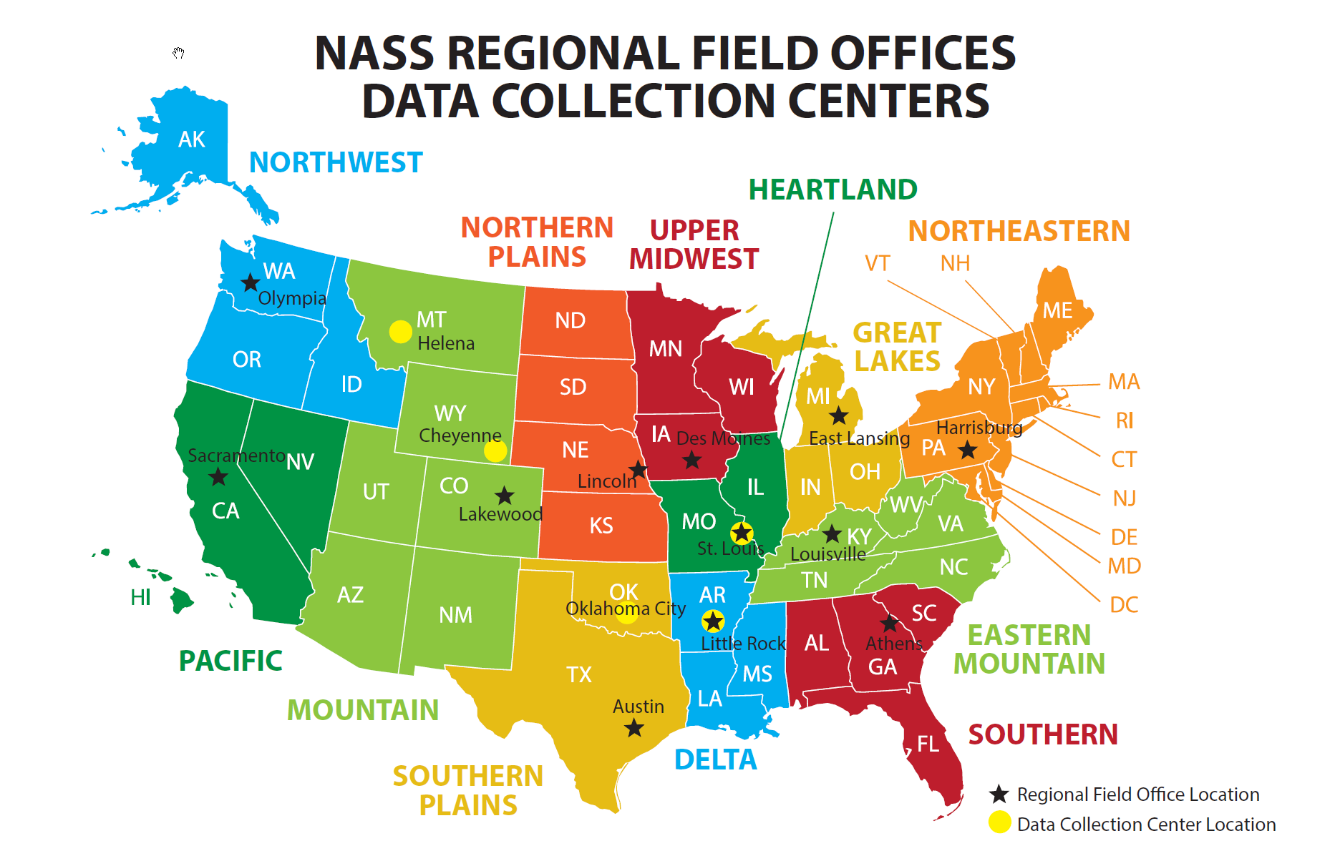
Our History
Introduction of NASS
Established in 1863
Named the “Division of Statistics”
First report on crop conditions
NASS Today
More than 900 personnel
Serving all 50 states and Puerto Rico
Centralized data collection and processing
3,000 enumerators
Notes:
TALKING POINTS:
NASS was established in 1863 and originally named the “Division of Statistics”
The first crop report developed in the new division was on crop conditions
NOW, NASS has more than 900 personnel, serves all 50 states, and Puerto Rico
We have 12 regional field offices and a State Statistician in every state
And a National Operations Center that centralizes our data collection and processing

Slide 5
Our Core Values
^{Policy relevance}
^{Objectivity}
^{Credibility}
^{Trust}
^{Commitment}
Statistics with Integrity
Relevance
Credibility
Trust
Independence

Slide 6
What We Do…
Collect, assemble, process, and disseminate U.S. agricultural data
Conduct and publish hundreds of annual surveys and censuses
Conduct the detailed Census of Agriculture every 5 years
Partner with state ag departments, trade associations, universities, and others
Conduct research to advance statistical science

Slide 7
What We Do Not Do…
We do not…
Set policy
Regulate activities
Permit influence
Disclose the identity of respondents
Favor any group above others

Slide 8
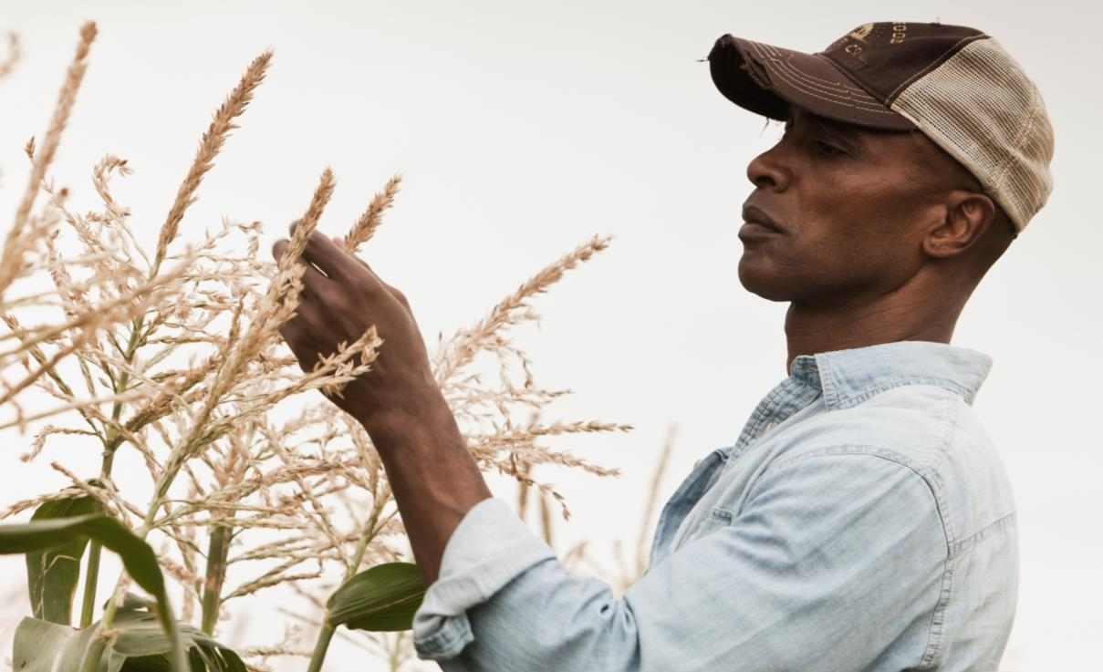
Who Do We Serve?
Farmers and Ranchers
Notes:
TALKING POINTS:
NASS serves farmers and ranchers across the country.
These farmers and ranchers are. . .
The producers we rely on to complete our surveys and to enable us to accurately reflect the nation’s agriculture, and
Large ag businesses, small-to-medium sized family-owned operations, and niche farms and ranches.

Slide 9
Who Do We Serve?
Data Users
Notes:
This even includes other USDA agencies.

Slide 10
Who Uses NASS Data
Agribusiness
Legislators
USDA Leaders
Farm Groups
Farmers and ranchers
Banks and other lending institutions
Commodity traders
Researchers
Notes:
Agribusiness
input providers (equipment, chemicals, fertilizers, seeds)
Legislators
Shape farm policy
USDA Leaders
Implement farm policy
Farm Groups
formulate positions and promote legislation
Farmers and ranchers
Production & marketing decisions
Banks and other lending institutions
Commodity traders
Researchers
Projections of coming trends
Economic implications
Alternative courses of action for producers

Slide 11
You Can Rely on NASS Data To…
Determine productivity and yields
Track trends
Set prices
Improve operational efficiencies
Reduce risk
Negotiate cash rents
Identify trends, best practices, and patterns
Analyze consumer demand
Notes:
TALKING POINTS:
As a producer, there are many ways you can rely on NASS data during day-to-day operations.
Here are some examples….

Slide 12
Helping Them Work Smarter
Working smarter means data users are able to…
Use reliable facts and figures to…
Make well-informed decisions that…
Eliminate guesswork, reduce risk, and improve profitability.
Notes:
The stronger the response, the better the data. The better the data, the better the decisions.
Ways the data are used: Farm Bill, Assistance Programs (e.g. loans), Disaster Relief, funding research, etc.

Slide 13
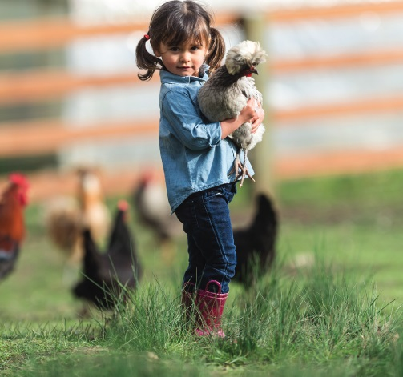
Marketing Matters…
Build partnerships – Provide toolkit (e.g. FAQs, Ads, Videos)
Produce testimonials and PSAs
Share benefits of responding/negatives of not – connect directly to surveys when possible
Make it easier/more convenient to respond (e.g. web form)
Make the data easier to obtain, more dynamic
Notes:
Response rates are waning for many statistical agencies. In an effort to maintain and increase ours our public affairs team…(Slide)…
From in-person meetings to teleconferences and emails, our public affairs team maintains regular contact with our promotion partners, regional field offices, and enumerators; they continue to build on and update the partner tools for partner use (HQ works at the national level whereas the regional and state offices tailor the tools and the messaging to their local audiences). PAO conducts social media campaigns through Facebook, Twitter, and the USDA Blog, and works closely with USDA Radio, NAFB, and RFD-TV among other media. They also provide media training to NASS staff, work with freelancers, and, when funds are available, have done some strategic advertising.
In addition, farmers and ranchers receive presurvey postcards and emails. Reminder postcards and emails. Phone calls, autodial messages, and sometimes even farm visits.
The one thing that has proven to be most influential, most successful in getting producer buy-in has been the messages coming from our partners who are often also our data users.

Slide 14
Your Partnership is Important…
Help us spread the word to farmers and ranchers about the importance of responding to NASS surveys and censuses – how the resultant data can have a direct impact on their operations, industries, and communities.
Notes:
The Ask

Slide 15
2017 Census of Agriculture
Data Release
Notes:
Slide 1 - 2017 Census of Agriculture Data Release
Mr. Secretary. We would like to highlight some high level results from the 2017 Census of Agriculture in this embargo briefing. We will be publishing nearly 6.4 million distinct data points at noon on April 11 with a several million more in the near future. I promise to only highlight a few of the insights available from these data today. We are excited to work with your team and all data users to further explain and explore this valuable public resource.
Add background notes below this line.

Slide 16
History of the Census of Agriculture
The first Census of Agriculture was conducted in 1840 in 26 states and the District of Columbia
175 years later:
The 2017 Census of Agriculture is the 29th in the series, and the 5th conducted by NASS
In 1997 the Census was transferred from the Census Bureau to NASS
The Census encompasses 50 states, Puerto Rico, and outlying areas
Data are available for:
National, state, and county levels
Congressional districts, watersheds, and zip codes
Notes:
Slide 3 – History of the Census of Agriculture
Just a few comments regarding the Census. Conducted once every five years, the census covers virtually every aspect of U.S. agriculture, providing a complete count of the nation’s farms and ranches and the people who operate them. It looks at land use and ownership, production practices, expenditures and other factors that affect the way farmers do business and succeed in the 21st century. The first census of agriculture occurred in 1840. The 2017 Census of Agriculture is the 29th in the series and the 5th census conducted by NASS.
The power of the Census is the ability to visualize and understand important change for key topics in agriculture at National, State, and County levels.
---------------------------------------------------------------------------------
Add background notes below this line.
The censuses of agriculture, which began in 1840, were originally conducted every 10 years in conjunction with the censuses of population. In that first 1840 census, about 70 percent of the population reported that they were engaged in agriculture. Sixty years later, in 1900, over 60 percent of the U.S. population still lived in rural areas.
The census, conducted once every five years, covers virtually every aspect of U.S. agriculture, providing a complete count of the nation’s farms and ranches and the people who operate them. It looks at land use and ownership, production practices, expenditures and other factors that affect the way farmers do business and succeed in the 21st century.
For the 1997 census of agriculture, the responsibility of the conduct of the census moved from the Census Bureau to the National Agricultural Statistics Service (NASS). NASS has conducted the Census of Agriculture since the 1997 transfer of authority from the Census Bureau.
The census reports on agriculture in all 50 states and Puerto Rico and the outlying areas. In addition to reporting agricultural information at the national, state, and county levels, the census also summarizes information for other geographic areas of interest, such as congressional districts, watersheds and zipcodes.
This is the most complete agricultural data resource available. It provides comprehensive and objective information for every state and county in the nation.
The census also includes a number of follow-on surveys. For example, currently an irrigation and aquaculture survey are underway. The survey is based on those who responded that they had irrigated acres or aquaculture on the 2017 census. Other follow-on surveys will include organics, horticulture, and local foods.
Consistent with federal law, NASS is committed to keeping all individual information confidential. Processes are in place to ensure that when data are reported at the county level, for example, the information cannot be linked to any individual producer.

Slide 17
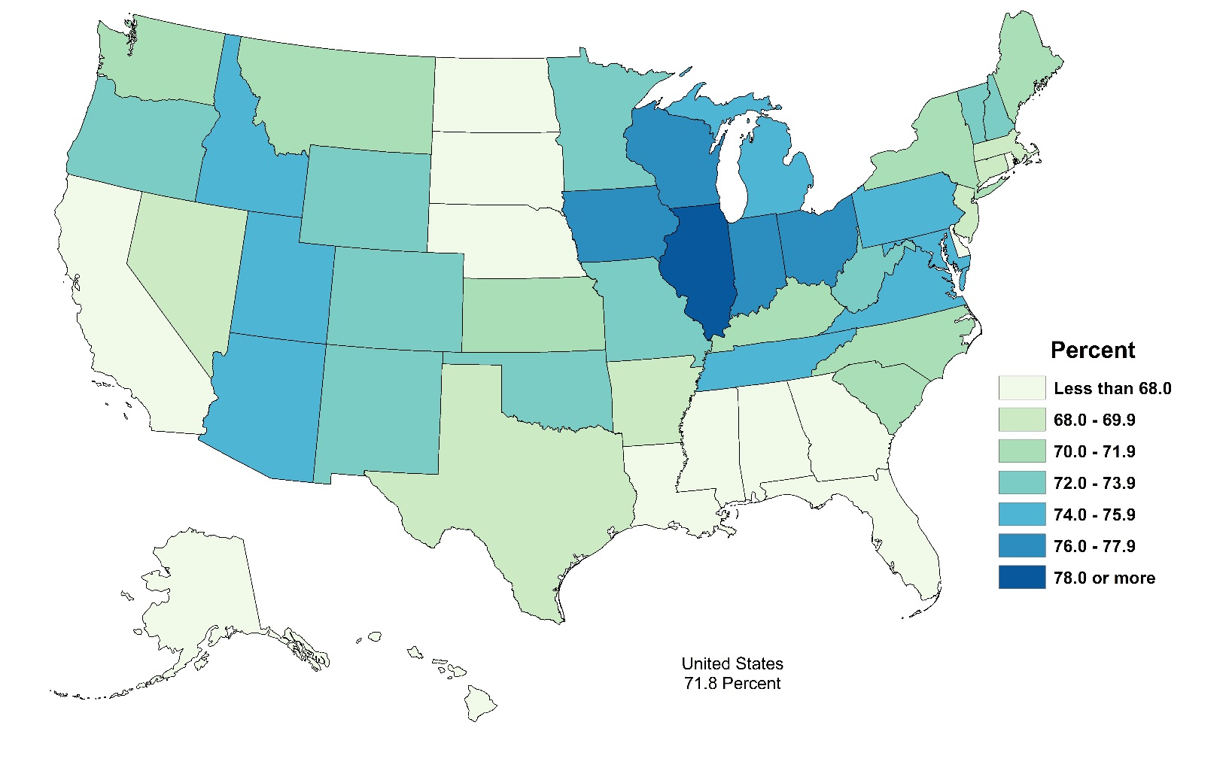
Census Data Collection
Response Rate by State, 2017
Return Rate by Mode, 2012 and 2017 (percent of returns)
U.S. = 71.8%
Notes:
Slide 4 – Census Data Collection
As you may recall, the overall response to the 2017 Census of Agriculture was just shy of 72 percent. This is down 2.8 percentage points from the 2012 effort. Response rates were highest in the Midwest and in the Great Lake states, and lower in the Southeast, Northern Plains and California.
Turning our attention to the bar chart, I would note that in 2017 NASS made a concerted effort to improve the respondent experience by completely revamping our online reporting tool.
While most census data is reported via the mail, nearly one-quarter of all persons receiving the form in 2017 responded over the internet, almost doubling the response from this mode in 2012.
-----------------------------------------------------------------------------
More background if needed:
Returns by mode do not add to 100%. Remaining records were replicated/estimated.
The census is primarily a mail survey. NASS mailed over 3 million paper forms. Instructions informed producers that they could complete the form on-line. Completed paper forms were returned to the National Processing Center (NPC) in Indiana.
Attempts were made to contact people who did not respond by mail or on-line by telephone or in face-to-face interviews.
NASS expends great effort to collect census information from every producer. Additional efforts are made to obtain responses from extremely large or unusual operations that could impact on state-level estimates. Many of these producers were contacted in person if they did not respond on the census form and could not be reached by telephone.
Note: The census reference year is 2017 so pre-notifications and census forms were sent in late 2017. These were followed with reminder calls, additional mailouts, phone follow-up, and a final notification in 2018.
Forms were checked in as they were received so that the responding producers would not receive further messages. An electronic image was made of each complete form, and the data were entered into the data base. The data were then sent to be edited and reviewed.

Slide 18
Number of Farms and Land in Farms, 1997-2017
2012 | 2017 | % change
Number of farms
2,109,303 | 2,042,220 | -3.2
Land in farms (acres)
914,527,657 | 900,217,576 | -1.6
Average farm size (acres)
434 | 441 | +1.6
Number of Farms (millions)
Land in Farms (million acres)
Notes:
Slide 6 – Number of Farms and Land in Farms, 1997-2017
The number of farms at 2.04 million decreased 3.2% from 2012 to 2017, or about 67,000 farms, while land in farms was down 1.6%, or 14.3 million acres. The average size of farm increased 1.6% from the previous census. The last 20 years has seen a gradual decline in total farms and land devoted to agriculture.
-----------------------------------------------------
However, the area of harvested cropland has increased slightly since 1997, with an increase of 1.1 million acres to 320 million acres, the highest it has been since 1997. Total cropland has decreased by about 49 million acres since 1997 (from 445 million to 396 million).
None of the changes in farms, land in farms, or average farm size from 2012 to 2017 were statistically significant.
When we have the CVs and significance: For the 2017 census, we are providing the data user with a measure of reliability, the coefficient of variation or CV, for each of our reported values. In general, estimates with small CVs are more reliable than those with larger CVs. The CV can also be used to find the margin of error.
The CV is the standard error of the estimate divided by the estimate.
The standard error is equal to the product of 100 * CV * “the estimate”. The margin of error is about twice the standard error.

Slide 19
Number of Farms and Land in Farms, by Size Category, 2017
Number of Farms (thousands)
Land in Farms (million acres)
U.S. Farms = 2,042
U.S. Land = 900.2
* Statistically significant difference from 2012
* Statistically significant difference from 2012
Notes:
Slide 11 - Number of Farms & Land in Farms, by Size Category, 2017
On the left panel of this slide we show the same 2017 farm numbers by size of farm that we saw in the previous slide. The panel on the right side ties in the land in farms for each of those categories. The 2000 acre + category of farms controlled 58% of land in farms in 2017. This group’s influence has shown a continuous increase over the last 20 years, increasing over 8 percentage points over the 20 year period.
Now we would like to turn our attention to farm economics.
----------------------------------------------------------------------
Add background notes below this line.
2000 + acres farms control, by census:
2017: 58%
2012: 56%,
2007: 54%,
2002: 52%
1997: 49.8%

Slide 20
Farms and Value of Production, by Sales Category, 2017
Number of Farms (thousands)
Value of Production ($ billions)
U.S. Farms = 2,042
Notes:
Slide 14 - Farms and Value of Production, by Sales Category, 2017
Similar to the slide we saw a few minutes ago, this slide shows the same farm counts by value of sales in the left panel for 2017 as was shown in the previous slide. The right panel shows just how dominant the contribution of farms with a million dollars of sales or more are to total value of sales. In fact, more than 2/3 of the almost 389 billion in total value of sales in 2017 come from farms with greater than one million in sales. These 77 thousand farms represent less than 4 (3.8) percent of the total farms in the US.
The share of sales coming from farms with value of production greater than $1 million increased from 41% in 1997 to 69% in 2017.
Add background notes below this line.

Slide 21
Total Value of Agricultural Production by Location, 2017
TVP by State as Percent of U.S. Total
Top 10 States | TVP ($ billions)
California | 45.2
Iowa* | 29.0
Texas | 24.9
Nebraska | 22.0
Kansas | 18.8
Minnesota* | 18.4
Illinois | 17.0
North Carolina | 12.9
Wisconsin | 11.4
Indiana | 11.1
6
9
4
2
7
10
1
5
8
3
U.S. = $389 billion
* Statistically significant difference from 2012
Notes:
Slide 15 - Total Value of Agricultural Production by Location, 2017
In terms of TVP California remains the top agricultural state by far, showing an increase in sales of $2.6 billion from 2012, unlike most other top 10 states. California produced 12 percent of the value of all agricultural products sold in the US in 2017, or $45 billion. The top 10 states contributed 54% of the total value in 2017. There are several states with similar sales just outside of the top 10. Georgia, for instance, was ranked 15th with sales of $9.6B.
---------------------------------------------------
The top 10 states for value of ag products sold are California ($45 billion), Iowa ($29b), Texas ($25b), Nebraska ($22b), Kansas ($19b), Minnesota ($18b), Illinois ($17b), North Carolina ($13b), Wisconsin ($11b), and Indiana ($11b).
Georgia ranked 15th, with sales of $9.6b.
States with large changes from 2012 to 2017:
CA up $2.5b, IA down $1.9B, NE down $1.1b, MN down $2.9b.

Slide 22
Value of Production, Crops and Livestock, 1997 - 2017 ($ billions)
Notes:
Slide 17 – Value of Production, Crops and Livestock, 1997-2017 ($ billions)
In this stacked bar graph we can see the Total Value of Production increasing across time through 2012. We should note that all of the values shown are in nominal dollars – that is not adjusted for inflation.
Although the 2012 yields for many major field crops were drought reduced. Crop prices dropped substantially between 2012 and 2017 while livestock prices decreased slightly from 2017.
Compared to 2012, total value of production has decreased slightly overall. Livestock value of sales is up over 2012, while crop sales are down. The balance between crop and livestock sales in the current census reverted to the more typical pattern seen prior to 2012.
-----------------------------------------------------------------------
Compared to 2012, total value of production has decreased slightly overall. Livestock value of sales is up over 2012, while crop sales are down. The 2012 represented one of the years with some of the highest prices for crops. For almost census years since 1982 (except 2012) the value of livestock sales has exceeded crop sales. The current census is reverting to the usual pattern.
Crop sales in 2017: $194b, down 9% from 2012’s high of $212b
Livestock sales in 2017: $195b, up 7% from 2012’s $182b
http://quickstats-review/results/7543F373-0ACF-38EC-BBD6-DEBE325013E9#9482BE68-849C-3C4F-8C55-47D528C6CDA1
Trends over time in value of production
Total value down from 2012
Share of crop and livestock sales
Census values are always shown as current

Slide 23
Farms with Internet Access
As a Percent of Total, by County, 2017
By Type, 2012 and 2017 (percent)
U.S. = 75%
* Statistically significant difference from 2012
Notes:
Slide 23 - Internet Access
USDA is investing heavily in broadband and high speed access is a top priority for USDA and rural America. The Census captures internet access on the farm by type. Overall, internet access increased from 70% in 2012 to 75% in 2017. In the map one can see the areas that tend to lead and lag. Generally, internet access rates are higher in the West and Northern states. Note the low access rates on and near the Navaho nation.
The right panel details the percent of those with access by type of internet connection. Farms’ access through higher speed options such as cable modems, mobile and fiber optic increased from 2012 to 2017. Almost all of the categories showed significant shifts since 2012.
----------------------------------------------------------------------------
Internet access increased from 70% in 2012 to 75% in 2017. Internet access rates are higher in the West and Northern states. Farms’ access through higher speed options such as cable modems, mobile and fiber optic increased from 2012 to 2017. Percent by type of access is calculated as a percent of farms with internet access.

Slide 24
Average Age of Producers
All Producers, by County, 2017
All and Primary Producers, 2002 - 2017
 | All | Primary
2002 | 53.2 | 55.3
2007 | 54.9 | 57.1
2012 | 56.3 | 58.3
2017 | 57.5 | 59.4
U.S. = 57.5
Notes:
Slide 25 – Average age of Producers
The average age of farmers is an item that generates a lot of interest. In the past we have described farm decision-makers as operators. Based on testing and advice from the panel we learned the term “producer” better reflects persons involved in farm decision making. We use the term producer throughout the 2017 publication.
Also, note that beginning in 2017 we allowed more than one person to designate themselves as a principal producer for a farm. To be able to compare back to prior census collections we selected the principal producer making the most decisions for the farm to be represented in this table as primary.
In the map panel of this slide we can see the average age of all producers at the county level. Average age varies across the US. Producers in the Southeast and Southwest tend to be older than the overall average.
Looking at the table on the right, the census shows an aging producer population, with the average age increasing by about one year per census cycle. The average age of primary producers increased from 58.3 in 2012 to 59.4 in 2017 continuing that trend.
-----------------------------------------------------------------
The average age of farm producers is a long running data item in the Census of Agriculture, as well as one that received a lot of attention each census cycle. Typically, the census shows an aging farmer population, with an increase of an additional one year to the average each cycle. The 2017 shows a continuing of that trend. For 2017, comparisons can be made over time for all producers, as well as the primary producer. The average age of all producers increased by 1.2 years from 2012 to 2017 to 57.5, and the average for the primary producer increased by 1.1 years, to 59.4. As we talked about previously, the primary producer is the bridging variable between the 2012 and 2017 Census. There is one primary producer defined per farm, and is the variable most equivalent to the principal operator in 2012.
Average age varies across the U.S. Producers in the Southeast and Southwest tend to be older than average.

Slide 25
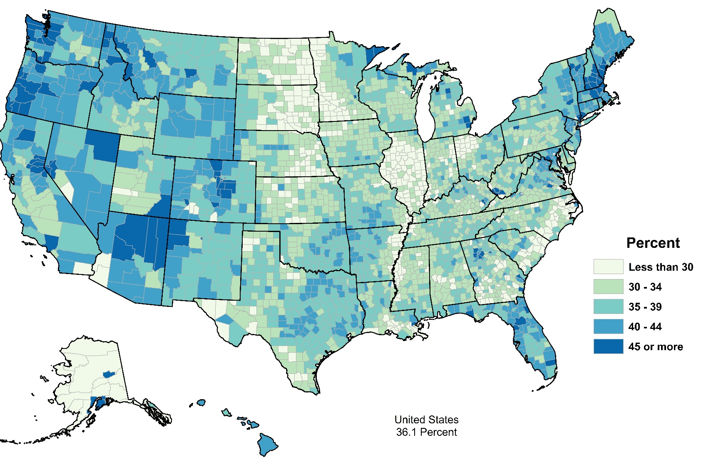
Producers by Sex, 2017
Female Producers as a Percent of Total
Producers
 | Female | Male
Number | 1,227,461 | 2,172,373
Average age | 57.1 | 57.7
Farms
Number | 1,139,675 | 1,867,308
Average farm size (acres) | 340 | 463
Average TVP | $129,792 | $204,513
U.S. = 36%
Notes:
Slide 30 -- Producers by Sex, 2017
36% of all producers are female and 56% of all farms have at least one female decision maker. On average, farms with a female producer are smaller in terms of both acres and dollars. Similar to 2012, the map shows distinct regional differences in the tendency for farms to have a female producer.
----------------------------------------------------------------------------------------------------
The share of farms with a female producer is 36%, and the female producers comprise 36% of all producers. On average, farms with a female producer are smaller in terms of both acres and dollars.

Slide 26
Producer Decision Making, by Sex and Age, 2017 (percent)
Notes:
Slide 32 -- Decision Making, by Sex and Age, 2017
As part of the recommendations from the expert panel, the 2017 Census of Agriculture also included a series of new questions asking about specific types of decisions farm producers made for the operation.
The chart on the left details decision-making by males and females while the chart on the right breaks down the data by age category. Female producers are most heavily engaged in the day-to-day decisions and record keeping and financial management aspects of the farm.
Young producers are more likely than other age groups to make decisions regarding livestock and on average participated in fewer decisions than older producers though the difference was generally slight.
-----------------------------------------------------------------------------------------
The 2017 Census of Agriculture also included a series of new questions asking about specific types of decisions farm producers made for the operation. The charts above show the percent of producers by sex and age who made various types of decisions for the operation.
On average, female producers were involved in fewer decisions for the farm and ranch than male producers. Female producers participated at about the same rate in record keeping and financial management decisions for the farm as male producers.
In terms of age, younger producers on average participated in fewer decisions than older producers, though the difference in most cases was very small.

Slide 27
Producers with Military Service, 2017
As a Percent of All, by County
Producers
 | With Military Service | All
Number | 370,619 | 3,399,834
Average age | 67.9 | 57.5
Farms
Number | 355,393 | 2,042,220
Average farm size (acres) | 363 | 441
Average TVP | $114,876 | $190,245
U.S. = 11%
Notes:
Slide 28 – Producers with Military Service, 2017
The 2017 Census of Agriculture included a new question to identify producers who have served or are serving in the U.S. Armed Forces.
Overall, 11% of producers have military service. 17% of all farms have a producer who has served in the armed forces. The average age of a producer with military service is almost 68 years old. This average is much higher than the average age of all producers.
Farms with a producer with military service participating in decisions for the farm are smaller than average in terms of both acres and sales.
The share of farms with producers who have served in the military is highest in the Southeast.
-----------------------------------------------------------------------
The 2017 Census of Agriculture included a new question to identify producers who have served or are serving in the U.S. Armed Forces.
Overall, 11% of producers have military service. 17% of all farms have a producer who has served in the armed forces. The average age of a producer with military service is 67.9. This average is much higher than the average age of all producers.
Farms with a producer with military service participating in decisions for the farm are smaller than average in terms of both acres and sales.
The share of farms with producers who have served in the military is highest in the Southeast.

Slide 28
NASS Survey Process
Headquarters
Regional and State Field Offices
Headquarters
Questionnaire Design
Sample Design
Procedures
Edit/Summary Specs
Research
Enumerator Training
Data Collection
Editing
National Summary
National & State Analysis
Publication
State Summaries
Estimation
Comments
Analysis
Board Review & Briefings

Slide 29
Agricultural Statistics Board
“Lockup”
Lockup
Security
Analysis
Estimation
Board Review
Publish
Notes:
The Ask

Slide 30
Agricultural Statistics Board -Estimation Process
Board Estimate
Remote Sensing Data
Historical Data
Other Admin Data
Survey & Objective Yield

Slide 31
Why is a board process used…
To ensure consistency and standardization
To objectively evaluate National indications
To ensure highest security
To produce high quality results
Notes:
One example of our process/ongoing cycle:
In 2019, we will begin our evaluation & analysis of our Census effort, and solicit input from the public for content for the next Census of Agriculture.
I n 2020, we’ll conduct our first Ag Screener Survey and cognitive interviews, followed the next year by the second Ag Screener Survey and content test, etc.
Then in 2022, we conduct the Census of Agriculture again

Slide 32
NASS Statistics Prepared under “Lockup” Conditions
Corn Yield Forecasts
Soybean Yield Forecasts
Cotton Yield Forecasts

Slide 33
NASS Statistics Prepared under “Lockup” Conditions
Wheat Yield Forecasts
Citrus Production
Grain Stocks

Slide 34
NASS Statistics Prepared under “Lockup” Conditions
Acreage
Cattle
Hogs and Pigs

Slide 35
Why Does Data Quality Matter?
We need to publish the “right” number, not just “a” number
The whole world now knows how good our data are, some data are very good, but some need to improve
These statistics are too important to give less than our very best effort and ideas

Slide 36
Methodology & Reliability

Slide 37
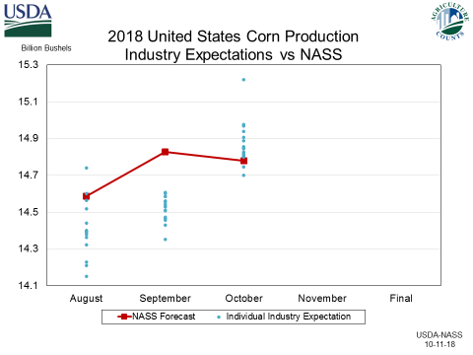
How Does Industry Compare?

Slide 38
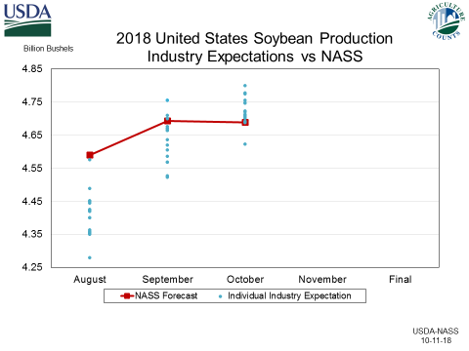
How Does Industry Compare?

Slide 39
Corn Price Changes
Low
Of Expectations

Slide 40
Soybean Price Changes
NASS
Estimate
Low
Of Expectations

Slide 41
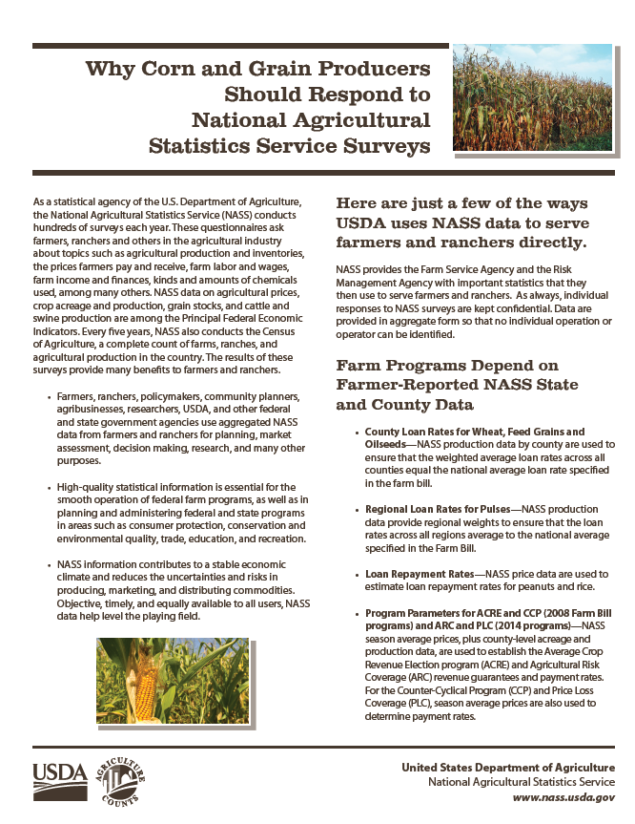
Response is Important

Slide 42
Farm Programs Depend on Farmer-Reported NASS State and County Data
County loan Rates for Wheat, Feed Grains & Oilseeds
Regional Loan Rates for Pulses
Loan Repayment Rates
Program Parameters for ACRE and CCP and ARC and PLC
Livestock Disaster Assistance Programs
Dairy Programs
Conservation Reserve Program (CRP)
Notes:
FSA uses

Slide 43
Farm Programs Depend on Farmer-Reported NASS State and County Data
Area Risk Protection Insurance Plan
Actual Revenue History (ARH) Pilot Program
Establishment of Transitional Yields
Establishment of Price Elections on Non-Program Crops
Notes:
RMA uses

Slide 44
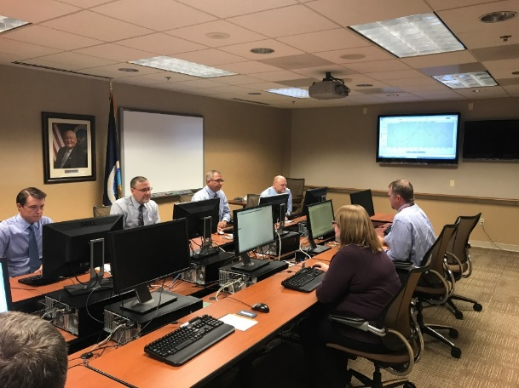
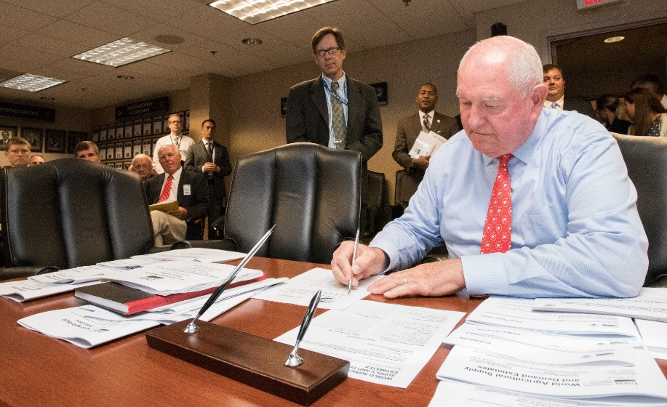
Agricultural Statistics Board. . .
Join us for “Lockup”
Notes:
Invite to lock-up?

Slide 45
Our Commitment. . .
We are committed to providing useful agricultural data to help data users work smarter.
For more information, visit www.nass.usda.gov
Contact: Hubert Hamer,
Administrator
Phone: (202) 720-2707
Email: Hubert.Hamer@usda.gov
Notes:
Invite to lock-up?

